Slide 1

DVA313 – Software Engineering 2: Project Teamwork

Slide 2
Headlines
INTRODUCTION
GROUP BACKGROUND AND AMBITION
PRE-PLANNING
DISCUSSIONS
QUESTIONS
DOCUMENTATION

Slide 3

INTRODUCTION
PROJECT 5: A CLOUD-NATIVE PERFORMANCE MONITORING SYSTEM
CLIENT : RISE - RESEARCH INSTITUTES OF SWEDEN

Slide 4


The goal of the project is to develop a cloud-native software system which monitors the performance of a virtual machine or container running on a hypervisor. The performance information should be written to a log file but also visualized through a dashboard where the user can configure the monitoring.
Suggested technology: This system could be implemented on Xen virtualization technology (hypervisor) and OpenStack open-source cloud platform. Alternatively, it could be implemented on Amazon cloud platform (AWS).
PROJECT DESCRIPTION

Slide 5
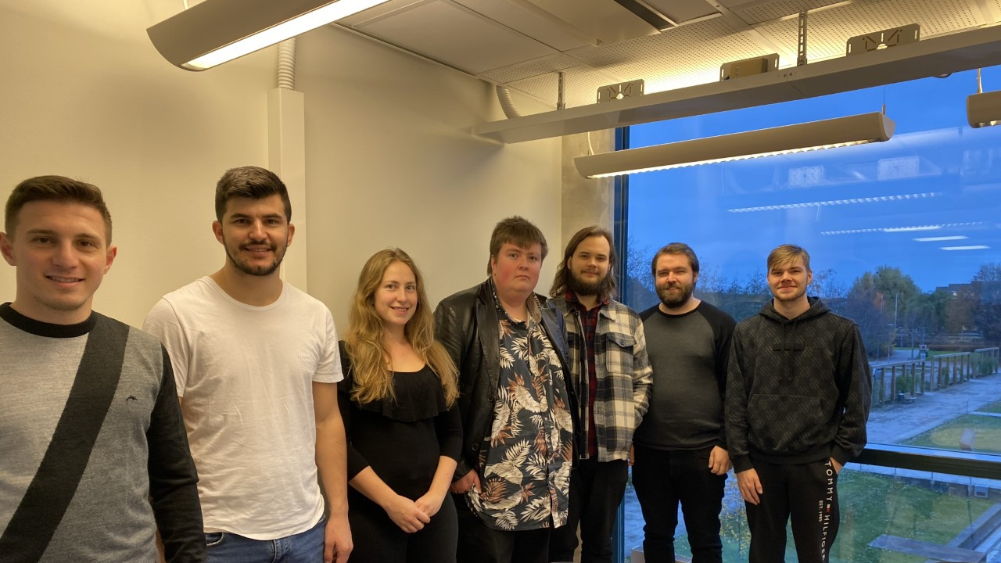
1.Roland Plaka
2.Gezim Cako
3.Sandra Eriksen
4.Ville Svensson 5.Gunnar Andersson
6.Emil Larsson
7.Johan Karlsson
GROUP MEMBERS

Slide 6
Emil Larsson – DVP, and ambition level 3
Ville – DVP, ambition level 5
Gunnar – DVP, ambition level 5
Roland – Security and Network, ambition level 5
Gezim – Informatics, Economics, and database experience ambition level 5
Sandra – DVP – ambition level 3
Johan – DVP, ambition level 3
GROUP BACKGROUND AND AMBITION

Slide 7
09.11.2020-Online Meeting (13:00 - 16:00): 1.Introduction between group members 2.Contacting with the client and awaiting an answer regarding setting up a meeting. We need more information regarding the actual assignment from the client before we can divide the work Decisions: 1.Project Manager : Emil Larsson 2.Daily Communication Channel : Discord Application
PRE-PLANNING

Slide 8
10.11.2020-Physical Meeting on Campus (14:15-16:15): Decisions: Platforms we will use are: 1.git for version control, Github for hosting 2.Discord for communication 3.Trello for project overview/scheduling 4.Google Drive for storage of documents Main Roles 1.Project Manager : Emil Larsson 2.GitHub Manager: Gunnar Andersson
PRE-PLANNING

Slide 9

1. The role distribution will be done after the meeting with the client. 2. We will start with project scheduling and planning phase.
DISCUSSIONS

Slide 10
If we decide to have a scrum master is it best if the project manager is the scrum master as well?
Are there any additional roles that you recommend for this project type?
Is there a template for how we should handle the documentation?
In project planning should we just include the technical part or is it important to include more general areas?
QUESTIONS

Slide 11
1.Project manager prepared the meeting protocol. 2.We will have a weekly meeting resume, reporting our tasks done, in process and to be done.
DOCUMENTATION

